Slide 1
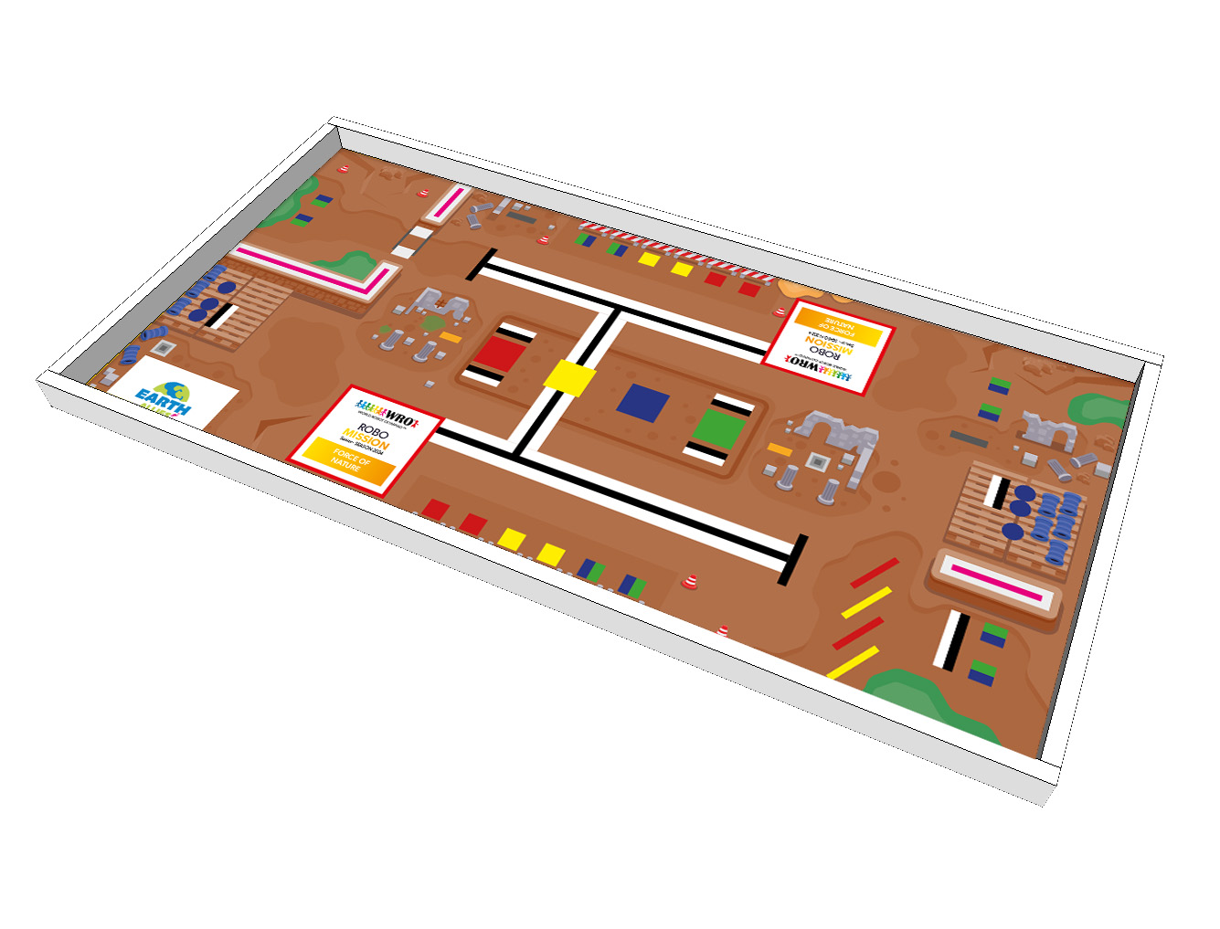
Bridge
Debris
Barriers
House Areas
Water Pipe
Start Area
Water Pipe
Collection Area
Barrier
Start Area
Material storage
House elements
on the field
Fence

